Slide 1

Simulation Project -
Team Tetrahedron
Simulation Project - Team D
Milestone #4 – Data Analysis
Milestone #4 –
Data Analysis
Image source: https://cdn.ottopix.de/wp-content/uploads/2019/04/Magdeburg-Panorama-%C3%BCber-der-Hubbr%C3%BCcke.jpg

Slide 2
Agenda
01
03
Simulation Project - Team D
Milestone #4 – Data Analysis
Data Analysis
Difficulties faced
Input data used and output values calculated.
An overview of the difficulties encountered
02
04
Quality analysis
Assumptions
An overview on ways to assess the validity of estimated functions
A brief about the assumptions made.

Slide 3
Data Analysis
Simulation Project - Team D
Milestone #4 – Data Analysis
01
Collecting the data and cleaning it
01
Estimating the underlying distributions function and testing the hypothesis for the inferences.
02
Plotting histogram and estimating the type of distribution
03
Validating the analysis by QQ plot and Chi square test

Slide 4
Input Data
Simulation Project - Team D
Milestone #4 – Data Analysis
01
Data from City of Magdeburg for Pedestrians, bicyclists and traffic light phases.
02
Data collected by last year group for the inter arrival time distribution function of vehicles.

Slide 5



Softwares used:
Simulation Project - Team D
Milestone #4 – Data Analysis
01
Python, Excel
02
Libraries used:
SciPy, Matplotlib, NumPy, Pandas

Slide 6
Collecting and cleaning the data
Simulation Project - Team D
Milestone #3 - Conceptual Model

Slide 7
Collecting and cleaning the data
Simulation Project - Team D
Milestone #4 – Data Analysis
The data is in the form of excel sheet.
data = pd.read_excel('E:/master/sem2/simproj/raw data/erich-weinert-str-raw.xlsx', sep=‘,”)
data[‘Raw Data].sort_values(ascending= True)
The outcome is data frame of sorted raw data

Slide 8
Plotting the Histograms
Simulation Project - Team D
Milestone #4 – Data Analysis

Slide 9

Histogram plotting
Simulation Project - Team D
Milestone #4 – Data Analysis
sns.distplot(data['Raw Data'], hist=True, kde=True, bins=int(np.sqrt(data.shape[0])), color = 'darkblue', hist_kws={'edgecolor':'black'}, kde_kws={'linewidth': 1})
Guess the type of distribution.
Guess work is error prone and might not result in accurate outputs.

Slide 10
Validation
Simulation Project - Team D
Milestone #4 – Data Analysis

Slide 11
Generating the QQ plot
Simulation Project - Team D
Milestone #4 – Data Analysis
01
Conventional distribution functions are taken.
dist_names = [st.expon, st.lognorm, st.norm]
02
Quantiles are calculated for every distribution type.
params = distribution.fit(data['Raw Data’])
loc = params[-2], scale = params[-1], arg = params[:-2]
data['j'] = pd.Series(range(1, data.shape[0] + 1))
data['f'] = (data['j'] - 0.5) / data.shape[0]
data['Finv'] = distribution.ppf(data['f'], loc=loc, scale=scale, *arg) if arg else distribution.ppf(data['f’], loc=loc, scale=scale)

Slide 12
Generating the QQ plot
Simulation Project - Team D
Milestone #4 – Data Analysis
01
Plot the QQ plot for Quantiles against Raw data
qqplot(data['Raw Data'], fit=True, dist=distribution, line='45')
plt.show()
02
Statistics that fits specific distribution functions are obtained
if distribution == st.lognorm: mean = np.log(params[-2]) std = params[-1]
elif distribution == st.expon: lamda = 1/scale minvalue = loc
else: mean = params[-2] std = params[-1]

Slide 13
Chi square test
Simulation Project - Team D
Milestone #4 – Data Analysis
01
Chi square test is called Goodness-of- fit test
02
Chi square test is performed to measure how well the observed data fits the expected values of the distribution.
03
chisquare = (np.power(np.array(Exp[i][j]) - np.array(counts[j]), 2)) / np.array(Exp[i][j])
calculated = np.sum(chisquare)
Exp = list of Expected values
Counts = list of observed values

Slide 14
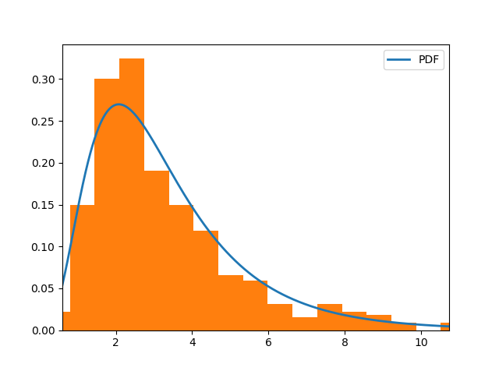
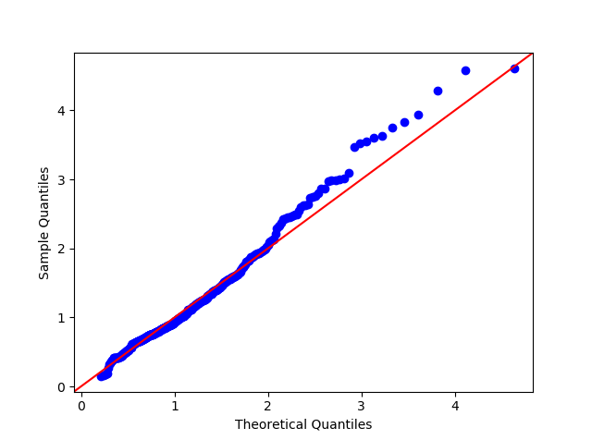
Findings of Erich-Weinert Str
Simulation Project - Team D
Milestone #4 – Data Analysis
Histogram
QQ plot
Distribution: Lognormal
Statistics : Mean = 1.161 , Standard deviation=0.533

Slide 15
Comparison of parameters for Erich – Weinert- Str
Simulation Project - Team D
Milestone #4 – Data Analysis
Distributions: | Exponential | Lognormal | Normal
Chi- square for k =31 bins | 209.96 | 38.797 | 1008.30
Sum of Squared error of quantiles against 45 degree line | 495.77 | 44.06 | 458.17
Is Chi- Square calculated less than tabulated
Distribution

Slide 16
Findings of Am Fuchsberg str:
Simulation Project - Team D
Milestone #3 - Conceptual Model
Distribution : Log normal
Statistics : Mean = 1.267 , standard deviation= 0.593
Findings of Leipziger str North:
Distribution : Log normal
Statistics : Mean = 1.511 , standard deviation= 1.112
Findings of Leipziger str South:
Distribution : Log normal
Statistics : Mean =0.662, standard deviation= 0.871

Slide 17
Pedestrians and bicyclists
Simulation Project - Team D
Milestone #4 – Data Analysis
For Am Fuchsberg to Erich- Weinert - Str
Distribution: Uniform distribution
Min value = 10 sec
Max value =20sec
Trams:
Leipziger str south Leipziger str north
Distribution :Truncated normal
Min value = 8 minutes, Max value = 12 minutes,
Standard deviation = 2 minute, mean = 10minutes

Slide 18
Traffic light phases
Simulation Project - Team D
Milestone #4 – Data Analysis
Timing | P1 | P2 | P3 | P4 | P5 | P6 | P7 | P8
P1 = uniform_discr(29, 30)
P2,P4,P6,P8 = 4
P5 = uniform_discr(39, 41)
P3 = uniform_discr(51, 62)
P7 = uniform_discr(65, 70)

Slide 19
Simulation Project - Team D
Milestone #4 – Data Analysis
Quality Analysis
An overview on ways to assess validity of estimated functions

Slide 20
Sum of squared errors
Simulation Project - Team D
Milestone #4 – Data Analysis
01
Sum of squared errors(SSE) gives the information about how far the expected data lies from the actual point.
02
Sum of squared error = 44.06

Slide 21
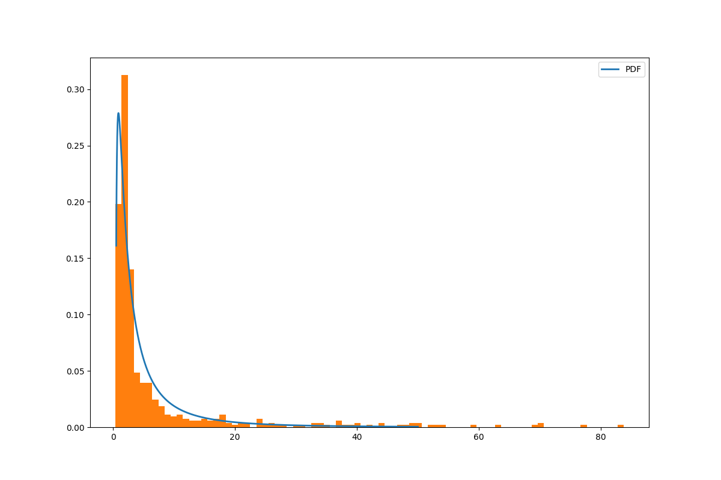
Trade- offs
Simulation Project - Team D
Milestone #4 – Data Analysis
Trade off between Variance due to outliers and estimation of distribution function.
Variance 145.705501
Data is censored there by reducing variance in order to get good estimate for the distribution function.

Slide 22
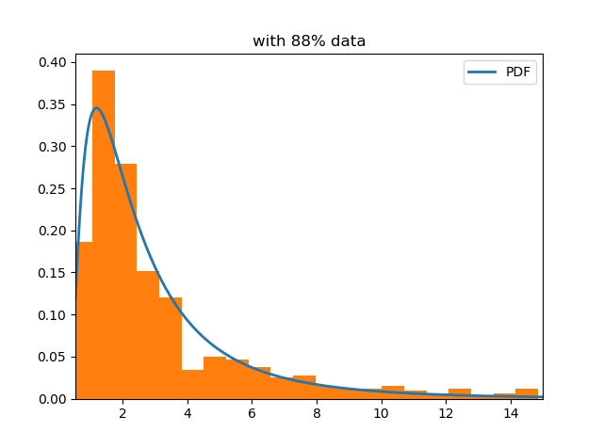
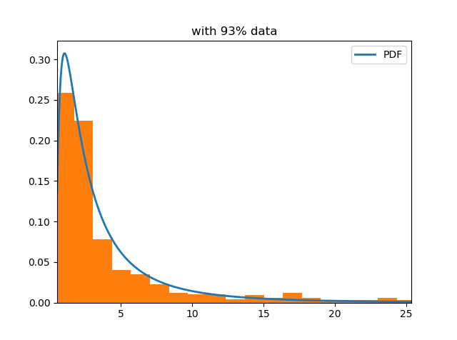
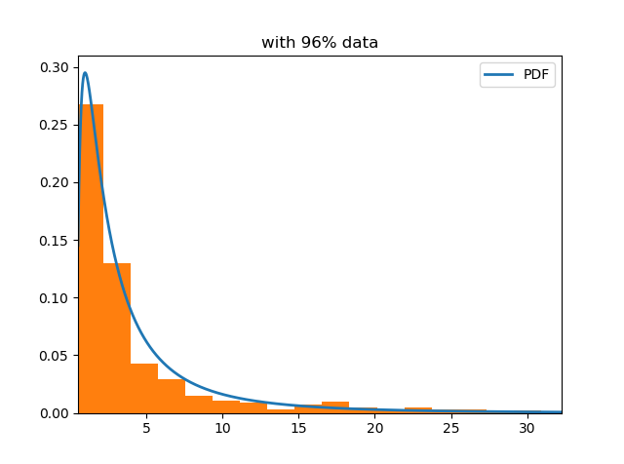
Simulation Project - Team D
Milestone #4 – Data Analysis
Pre-data censor
Post- data censor
Variance:
rejected null hypothesis with 95% C.I for all distribution types
Variance:
Lognormal: failed to reject null hypothesis with 95% confidence level at k=34
Variance:
Lognormal: failed to reject null hypothesis with 95% confidence level at k=83
Variance: 48.390222
Failed to reject null hypothesis for log normal distribution at k = 91

Slide 23
Assumptions:
Simulation Project - Team D
Milestone #4 – Data Analysis
01
We assume all the motor vehicles are of the same type.
04
We assume there are no major changes in the behavior of cars and pedestrians between different years
02
We assume all pedestrians and cyclists behave in the same way
05
We tried to fit the conventional distribution functions.
03
Pedestrians go in only one direction.

Slide 24
So far
Simulation Project - Team D
Milestone #4 – Data Analysis
Tasks completed and costs incurred so far

Slide 25
Tasks completed so far
✓
✓
✓
✓
Simulation Project - Team D
Milestone #4 – Data Analysis
Completed analyzing the data from previous years
Completed analyzing the data from the city of Magdeburg
Incorporated required elements in simulation model
Update work as issues in GitHub.

Slide 26
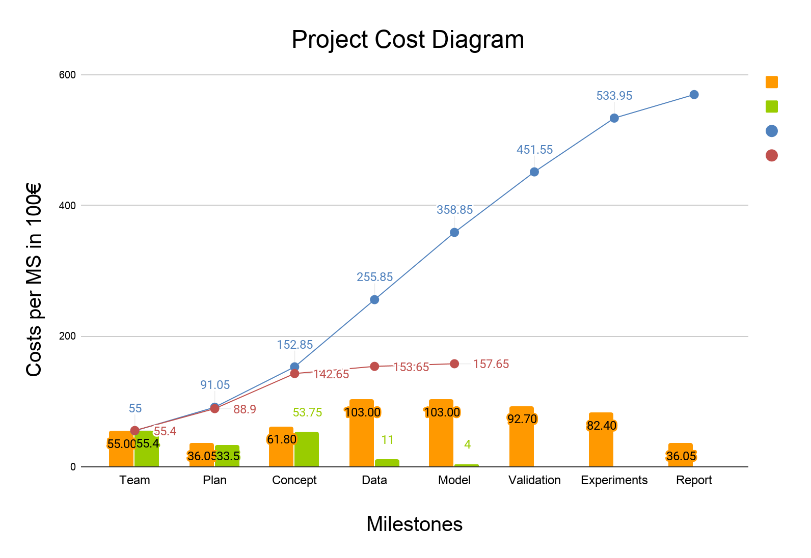
Cost comparison
Simulation Project - Team D
Milestone #4 – Data Analysis
Estimated cost
Actual cost
Cumulative estimate
Cumulative actual

Slide 27
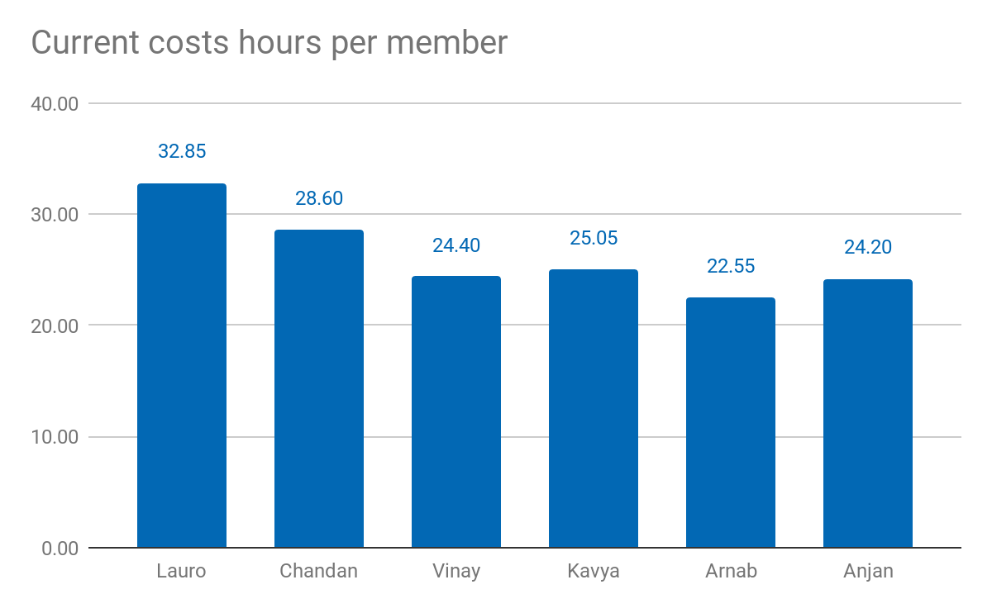
Current costs as % of total cost: 26.28%
Current costs: 15.765,00 €
Simulation Project - Team D
Milestone #4 – Data Analysis

Slide 28
Lessons learned
01
02
03
04
05
Simulation Project - Team D
Milestone #4 – Data Analysis
Have a proper justification for each slide
Guess work is error prone
Do the homework
Add only the necessary content on the slides
Update time chart the same day

Slide 29
05
Thank you!
Simulation Project - Team D
Milestone #4 – Data Analysis
Questions?

